Slide 1

ScribblePad – The developing blog
Presented By:
Tulasi Bodduluri
Deeksha Chelamalla
Naga Manikanta Chigurupati
Vidya Rajarajeswari Gummadi
Nikhitha Kasuvojula
Rushidhar Reddy Sheelam

Slide 2
Outline
Introduction
Problem Statement
Proposed Solution
Functional Requirements
Non-Functional Requirements
Demo
What have been accomplished?
Challenges faced
Acknowledgements

Slide 3
Introduction
ScribblePad is the innovative blog writing web application
Our mission is to create a writer-friendly platform, where they can share their ideas, and connect with readers to build a lively online community.

Slide 4
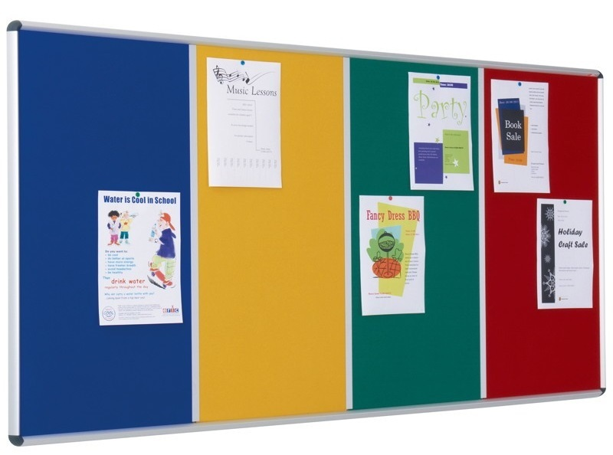

Current Situation at University
PROBLEMS
Communication gap
Missing important events
Opinions, problems, ideas
Other information
Students
Bulletin Board

Slide 5



Proposed Solution
Web Application
Student
Admin

Slide 6
Requirements
Requirements | Student | Admin | Other audience
User will be able to Register into the Scribble Pad | Yes |  | Yes
User Authentication will be done by sending OTP | Yes |  | Yes
User will be able to Login with their credentials | Yes | Yes | Yes
User will be able to view all categories | Yes | Yes | Yes
User will be able to create post | Yes
User will be able to view posts | Yes | Yes | Yes
User will be able to edit post | Yes
User will be able to delete post | Yes | Yes
User will be able to report post | Yes
User will be able to review a post |  | Yes
User will be able to view all profiles |  | Yes
User will be able to write comments to other user posts | Yes

Slide 7















Tools And Technologies
Frontend
Backend
Database
Other Tools

Slide 8
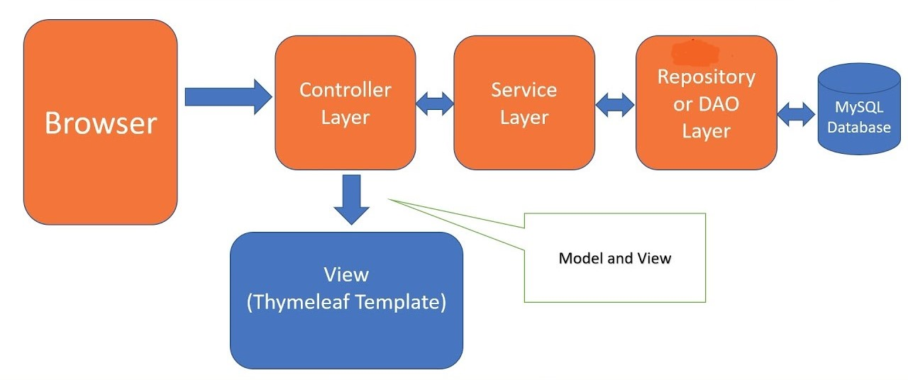
Spring MVC Workflow

Slide 9

Demo

Slide 10
What have been accomplished?
Admin and other users login
Admin pages for approving and rejecting posts
Displaying images
Implemented filter options for posts
Implemented paginations for pages
Sorting of posts
Implemented the comment section for the posts

Slide 11
Challenges faced
While Integrating the different parts
While loading and retrieving the data
Improper working of icon functionalities
Showcasing the images stored in the databases
Issues while encrypting password

Slide 12
Acknowledgement
https://www.w3schools.com/
https://www.google.com/
https://youtu.be/cR8ONcPKE1Q
https://stackoverflow.com/

Slide 13
Thank You

